Slide 1
Introduction to Programming
Spring 2022
Notes:
01/20/2022
1
1

Slide 2
Objectives
CSCI 1410
Dr. Salim Lakhani
2 /
Computer Programming
Algorithm
The Programming Process
Programming Languages
Installing Python and IDLE
Notes:
01/20/2022
2
2

Slide 3
Computer Programming
CSCI 1410
Dr. Salim Lakhani
3 /
Aspects of a computer program that must be designed:
The logical flow of the instructions
Step by step set of instructions
The way information is presented to the user
The program’s “user friendliness”
Manuals, help systems, and/or other forms of written documentation?
Notes:
01/20/2022
3
3
The logical flow of instructions
Step by step set of instructions
Tells computer what to do
The way information is presented to the user
How do we communicate with users.
I will give examples as we progress in this class
This will also dictate the user friendliness of the program

Slide 4
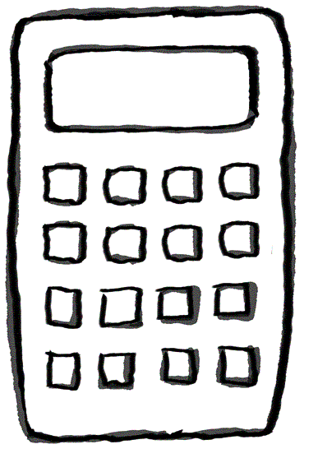
CSCI 1410
Dr. Salim Lakhani
4 /
Notes:
01/20/2022
4
4

Slide 5
Computer Programming
CSCI 1410
Dr. Salim Lakhani
5 /
Programs must be analytically correct as well.
Programs rarely work the first time they are programmed.
Notes:
01/20/2022
5
5
Analytically correct – It must do what it is supposed to do for all set of data.
Example – It can calculate sum of 5 numbers.
Can it also calculate sum of 10 numbers,
20 numbers, 100 numbers, one million
numbers and so on.

Slide 6
Computer Programming
CSCI 1410
Dr. Salim Lakhani
6 /
Programming Process
Design
Analysis
Experimentation
Notes:
01/20/2022
6
6

Slide 7
Design
CSCI 1410
Dr. Salim Lakhani
7 /
One way to show a particular problem can be solved is to actually design a solution.
This is done by developing an algorithm, a step-by-step process for achieving the desired result.
One problem – it can only answer in the positive. You can’t prove a negative!
Notes:
01/20/2022
7
7

Slide 8
Analysis
CSCI 1410
Dr. Salim Lakhani
8 /
Analysis is the process of examining algorithms and problems mathematically.
Some seemingly simple problems are not solvable by any algorithm. These problems are said to be unsolvable.
Problems can be intractable if they would take too long or take too much memory to be of practical value.
Computer Scientists talk about P vs NP computational complexity
Notes:
01/20/2022
8
8

Slide 9
Experimentation
CSCI 1410
Dr. Salim Lakhani
9 /
Some problems are too complex for analysis.
Implement a system and then study its behavior.
Notes:
01/20/2022
9
9

Slide 10
Computer Programming
CSCI 1410
Dr. Salim Lakhani
10 /
Programming languages have strict rules, known as syntax, that must be carefully followed.
Notes:
01/20/2022
10
10

Slide 11
Computer Programming
CSCI 1410
Dr. Salim Lakhani
11 /
Syntax
Rules of a language
English:
Subject Verb Object
Cat boy hugs
Cat hugs boy
Notes:
01/20/2022
11
11

Slide 12
Computer Programming
CSCI 1410
Dr. Salim Lakhani
12 /
Syntax
Rules of a language
Programming Language:
Language depended
3.2 + 10
3.2, 10, +
"High Five"
Notes:
01/20/2022
12
12

Slide 13
Computer Programming
CSCI 1410
Dr. Salim Lakhani
13 /
Semantics
Meaning associated with a syntactically correct string of symbols
English:
“Flying planes can be dangerous”
“This reading lamp hasn’t uttered a word since I bought it?”
Notes:
01/20/2022
13
13

Slide 14
Computer Programming
CSCI 1410
Dr. Salim Lakhani
14 /
Programming languages have only one meaning but may not be what programmer intended
Programmer wants to add two numbers (5 and 3) but wrote:
5 - 3
Notes:
01/20/2022
14
14

Slide 15
Computer Programming
CSCI 1410
Dr. Salim Lakhani
15 /
Syntactic errors
Common and easily caught
No syntactic errors but different meaning than what programmer intended (semantic errors)
Program crashes, stops running
Program runs forever
Program gives an answer but different than expected
Notes:
01/20/2022
15
15

Slide 16
Computer Programming
CSCI 1410
Dr. Salim Lakhani
16 /
A program is a set of instructions a computer follows in order to perform a task.
A programming language is a special language used to write computer programs.
Collectively, these instructions form an algorithm
Notes:
01/20/2022
16
16

Slide 17
Algorithm
CSCI 1410
Dr. Salim Lakhani
17 /
An algorithm is a set of well defined steps to completing a task.
The steps in an algorithm are performed sequentially.
Algorithms are like recipes
Notes:
01/20/2022
17
17

Slide 18
Algorithm
CSCI 1410
Dr. Salim Lakhani
18 /
An algorithm may be:
Incorrect
Correct but inefficient
May never end
Algorithm must be precise
Algorithm are written in pseudocode
Notes:
01/20/2022
18
18

Slide 19
Example of an Algorithm
Cooking Rice
Measure one cup of rice
Measure two cups of water
Pour water into a pot
Put the pot on the stove
Turn on the stove setting it to high
Boil the water
Add the rice to pot
Turn down the heat to simmer
Cover the pot
Cook for twenty minutes
Turn off the heat and remove the lid
CSCI 1410
Dr. Salim Lakhani
19 /
Notes:
01/20/2022
19
19

Slide 20
Example of an Algorithm
CSCI 1410
Dr. Salim Lakhani
20 /
Cooking Rice
Add the Rice
Turn Off the Heat and Remove the Lid
Measure the Rice and Water
Boil the Water
Cover and Cook till Rice is done
Notes:
01/20/2022
20
20

Slide 21
Example of an Algorithm
CSCI 1410
Dr. Salim Lakhani
21 /
Driving Direction from Denver to Colorado Springs
Take I-25 North
Take I-70 East
Take I-225 South
Take I-25 South
Notes:
01/20/2022
21
21

Slide 22
Example of an Algorithm
CSCI 1410
Dr. Salim Lakhani
22 /
Write an algorithm using pseudocode to calculate gross pay.
Get payroll data.
Calculate gross pay.
Display gross pay.
Notes:
01/20/2022
22
22

Slide 23
Example of an Algorithm
CSCI 1410
Dr. Salim Lakhani
23 /
Write an algorithm using pseudocode to calculate gross pay.
Display “How many hours did you work?”
Input hours.
Display “How much do you get paid per hour?”
Input rate.
Store the value of hours times rate in the pay variable.
Display the value in the pay variable.
Notes:
01/20/2022
23
23

Slide 24
Stages in Software Development
CSCI 1410
Dr. Salim Lakhani
24 /
Process for software development can be divided into five steps:
Writing specifications
Developing solution or algorithms
Coding algorithms
Testing
running
Notes:
01/20/2022
24
24

Slide 25
Writing Specifications
CSCI 1410
Dr. Salim Lakhani
25 /
Describe the problem to be solved
It can start with a concept
Specifications can be vague
Where do we get the specifications?
From users
Users might not know all the possibilities
Notes:
01/20/2022
25
25

Slide 26
Requirement Gathering
CSCI 1410
Dr. Salim Lakhani
26 /
Users might think we can do anything:
https://www.youtube.com/watch?v=BKorP55Aqvg
Notes:
01/20/2022
26
26

Slide 27
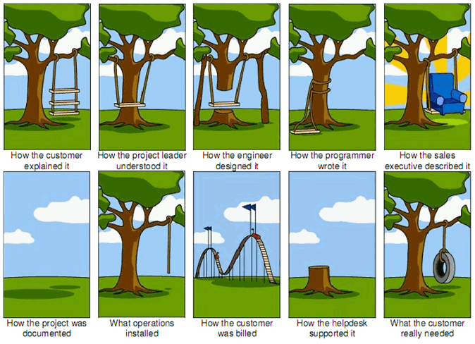
CSCI 1410
Dr. Salim Lakhani
27 /
Notes:
01/20/2022
27
27

Slide 28
Writing Specifications
CSCI 1410
Dr. Salim Lakhani
28 /
Bulleted list of functionalities included in the system
Notes:
01/20/2022
28
28

Slide 29
Programming Languages
CSCI 1410
Dr. Salim Lakhani
29 /
A computer needs the algorithm to be written in machine language.
Machine language is written using binary numbers.
Notes:
01/20/2022
29
29

Slide 30
Programming Languages
CSCI 1410
Dr. Salim Lakhani
30 /
The binary numbering system (base 2) only has two digits (0 and 1).
The binary numbers are encoded as a machine language.
Each CPU has its own machine language.
Motorola 68000 series processors
Intel x86 series processors
ARM processors, etc.
Example: 1011010000000101
Notes:
01/20/2022
30
30

Slide 31
Programming Languages
CSCI 1410
Dr. Salim Lakhani
31 /
In the distant past, programmers wrote programs in machine language.
Programmers developed higher level programming languages to make things easier.
The first of these was assembler.
Assembler made things easier but was also processor dependent.
Notes:
01/20/2022
31
31

Slide 32
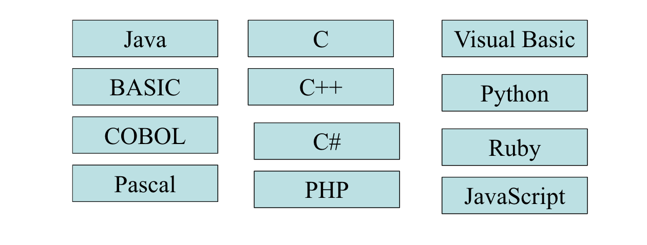
Programming Languages
CSCI 1410
Dr. Salim Lakhani
32 /
High level programming languages followed that were not processor dependent.
Some common programming languages:
Notes:
01/20/2022
32
32

